Slide 1



b-solutions
information session
DATE
20 March, 2025
TIME
11:00 - 12:00 CET
LOCATION
Online

Slide 2


Are you an actor in a border area facing a cross-border obstacle?
b-solutions can help!

Slide 3

Apply now on the
b-solutions website to get expert support in overcoming your
cross-border challenges.

Slide 4
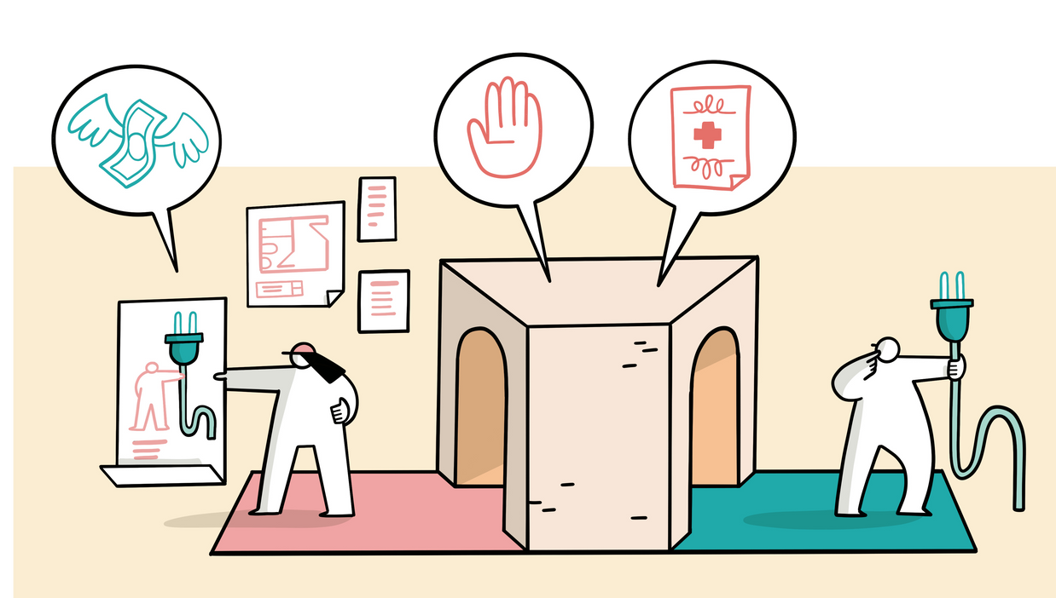
Receive a comprehensive report from an expert with a detailed analysis and actionable solutions tailored to your specific obstacle.

Slide 5

Ready to bridge the gap? Click the link to apply!

Slide 6

Are you an
actor in a border area facing a cross-border obstacle?
b-solutions can help!
Apply online for expert support

Slide 7
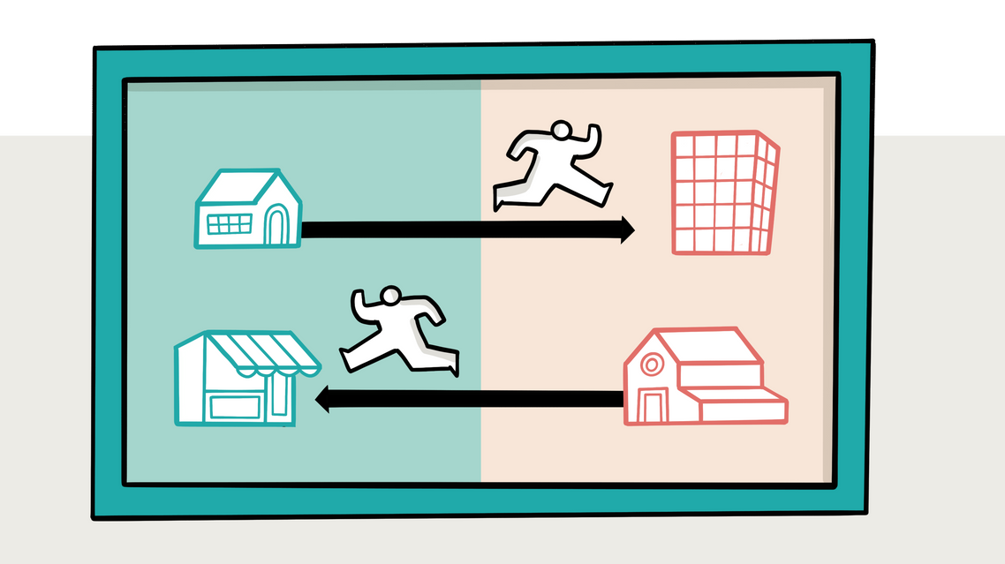
Are you an
actor in a border area facing a cross-border obstacle?
b-solutions can help!
Apply online for expert support

Slide 8
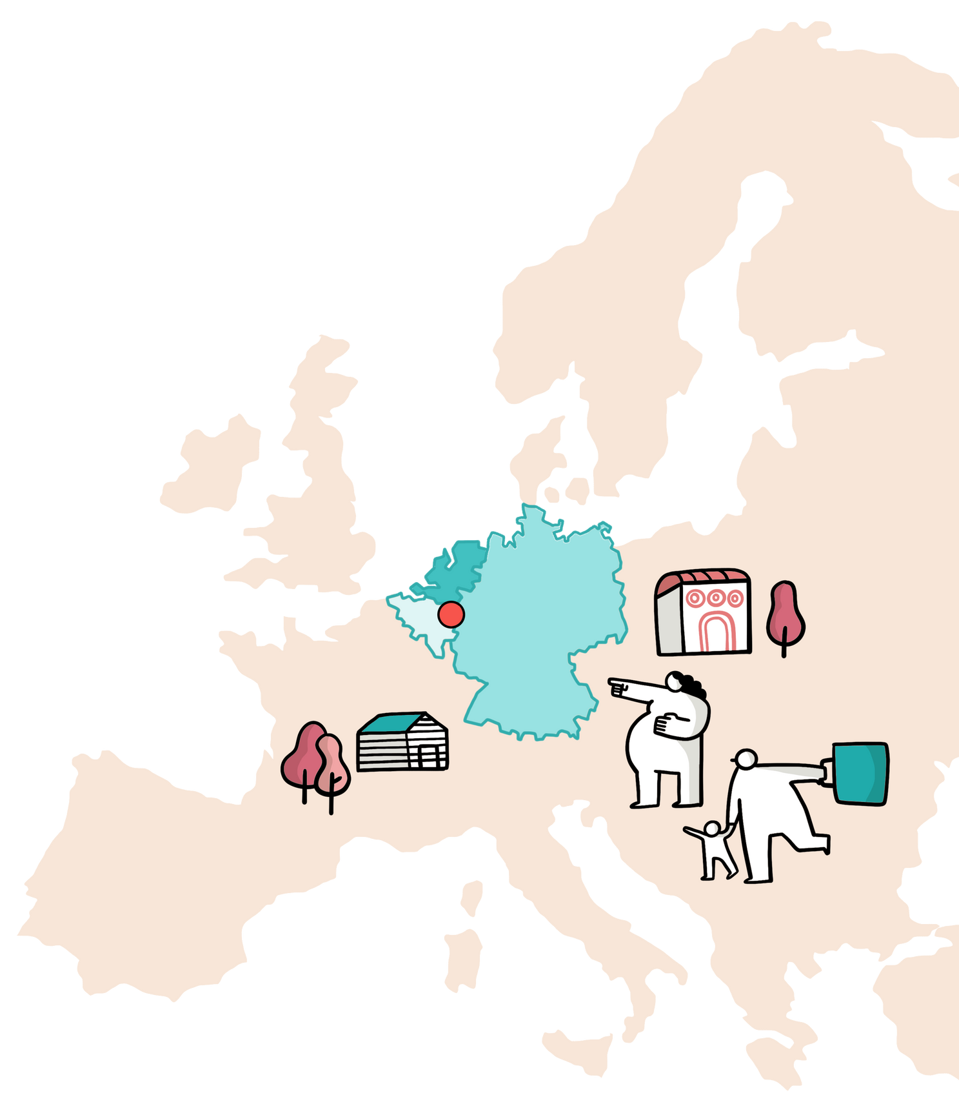
Are you an
actor in a border area facing a cross-border obstacle?
b-solutions can help!

